Slide 1
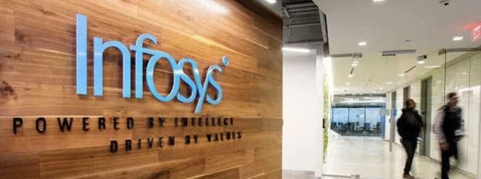
Financial Analysis & Valuation of Infosys Ltd
Subtitle:
Financial Modelling Capstone Project
FY2022–FY2026 Historical Analysis & DCF Valuation
Prepared by: Satyam Mishra

Slide 2
Company Overview
Infosys Ltd.
Global leader in IT services, consulting and digital transformation.
Provides technology solutions across digital services, cloud, AI, consulting and enterprise transformation.
Serves clients across multiple industries and geographies.
Strong global delivery model and diversified client base.
Key competitive strengths include brand reputation, skilled workforce and strong balance sheet.
Infosys operates in a structurally attractive technology-services industry with strong cash-generation capability.

Slide 3
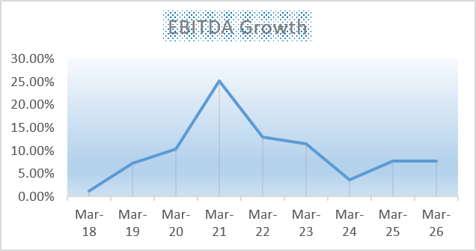
Historical Financial Performance
Key observations:
Revenue growth remained positive over the historical period.
EBITDA margin remained healthy, indicating strong operating profitability.
Net profit growth showed volatility across individual years.
ROCE remained strong and improved significantly over the period.
Overall, Infosys maintained strong profitability and capital efficiency.

Slide 4
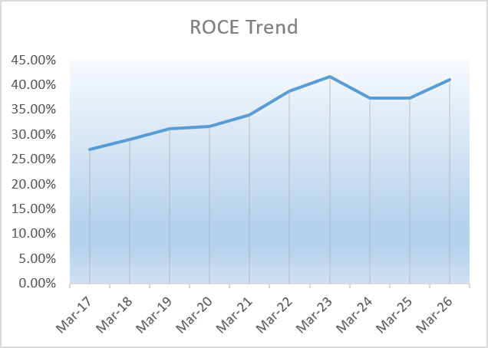
Historical Financial Performance
Revenue growth remained positive over the historical period.
EBITDA margin remained healthy, indicating strong operating profitability.
Net profit growth showed volatility across individual years.
ROCE remained strong and improved significantly over the period.
Overall, Infosys maintained strong profitability and capital efficiency.

Slide 5
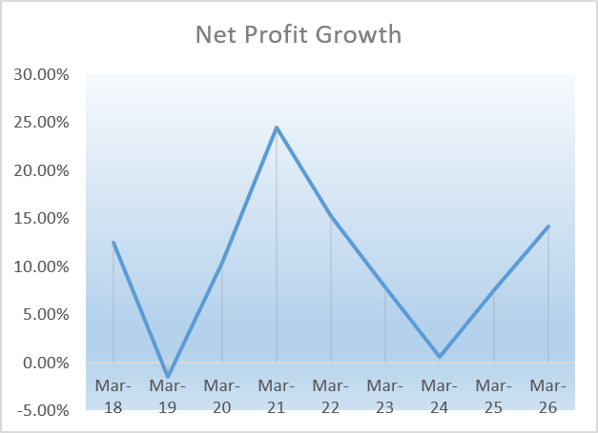
Trend & Profitability Analysis
Sales growth recovered after periods of moderation.
EBITDA growth showed significant fluctuations but remained positive in the latest period.
Net profit growth experienced volatility, followed by recovery.
ROCE increased from approximately 27% to 41%, highlighting efficient capital utilisation.
Strong ROCE supports the company's ability to generate attractive returns on invested capital.

Slide 6
Ratio & Fundamental Analysis
Liquidity
Company maintains adequate liquidity to meet short-term obligations.
Solvency
Low financial leverage and a strong balance sheet reduce financial risk.
Profitability
Healthy EBITDA and net profit margins.
ROCE of approximately 41% indicates strong capital efficiency.
Efficiency
Efficient utilisation of assets and working capital supports profitability.

Slide 7
Forecast & Financial Model
Forecasting approach:
Historical financial performance used as the base for projections.
Revenue, operating profitability, working capital and capital expenditure projected for the next five years.
Forecast assumptions reflect historical trends and expected business performance.
Projected FCFF increases from approximately ₹34,721 Cr to ₹42,823 Cr over the forecast period.

Slide 8
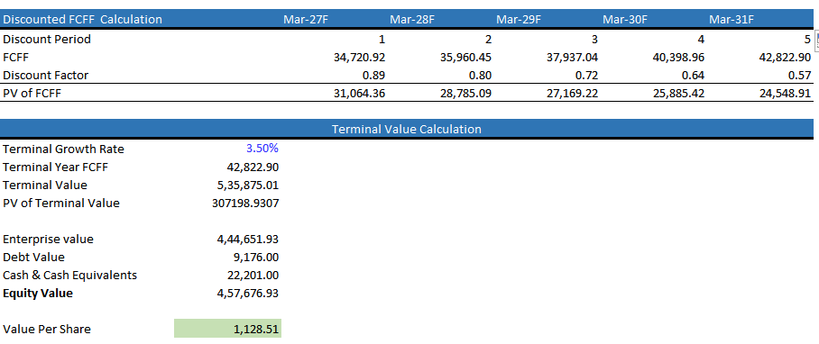
DCF Valuation
Valuation Output
Enterprise Value: ₹4,44,652 Cr
Equity Value: ₹4,57,677 Cr
Intrinsic Value/Share: ₹1,128.51
Metric | Value
Risk-Free Rate | 6.85%
Beta | 0.70
Cost of Equity | 11.94%
After-tax Cost of Debt | 3.37%
WACC | 11.77%
Terminal Growth Rate | 3.50%

Slide 9
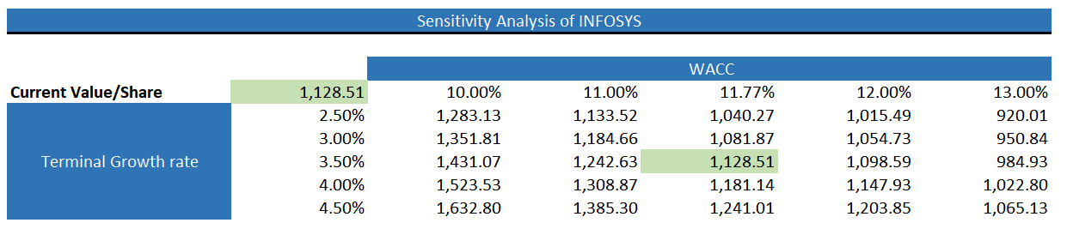
Sensitivity Analysis
Sensitivity analysis highlights:
Valuation is sensitive to changes in WACC and terminal growth rate.
Base case:
  WACC = 11.77%
  Terminal Growth = 3.50%
  Intrinsic Value = ₹1,128.51/share
Higher WACC reduces intrinsic value.
Higher terminal growth increases intrinsic value.

Slide 10
Investment Recommendation
HOLD
Current Market Price: ₹1,121
Intrinsic Value: ₹1,128.51
Potential Upside: 0.67%
Investment View
Infosys demonstrates strong profitability and capital efficiency.
ROCE remains strong at approximately 41%.
Balance sheet remains financially sound.
DCF indicates the stock is approximately fairly valued at the current price.
Limited upside provides insufficient margin of safety for a BUY recommendation.
Valuation remains sensitive to WACC and terminal growth assumptions.
Recommendation: HOLD

